Slide 1

Boy in the Tower
Monday Lesson One:
Read Chapter 1 and write a summary of the chapter

Slide 2




What does the word vibrant mean?
How many birds are on the front cover?
Using evidence from the front cover, why are the birds flying away?
How has the designer of this front cover made you want to read the book?

Slide 3
Boy in the Tower
Tuesday: Lesson Two
Activity 1

Slide 4
Vocabulary for Chapter 1
Can you come up with definitions for these words?
swaying
wispy
stealthily
daze
Notes:
Vocabulary information

Slide 5
Vocabulary for Chapter 1
Can you come up with definitions for these words?
swaying
To move slowly and rhythmically
wispy
Fine and feathery (often about hair, threads, smoke)
stealthily
To do something secretively and cautiously
daze
Feeling stunned or confused
Notes:
Vocabulary information

Slide 6
Speed Retrieval Challenge
The stain on the ceiling looked like:
A wiggly line B) A wobbly circle C) A wobbly mark
The roads are described as:
tiny-looking B) minute-looking C) miniature-looking
What colour were the bricks of the school?
A) Red B) Grey C) Brown

Slide 7
Speed Retrieval Challenge
The stain on the ceiling looked like:
A wiggly line B) A wobbly circle C) A wobbly mark
The roads are described as:
tiny-looking B) minute-looking C) miniature-looking
What colour were the bricks of the school?
A) Red B) Grey C) Brown

Slide 8
In Chapter 1, Polly Ho-Yen holds back lots of information from her reader. She leaves us with lots of unanswered questions.
Your Task
In your table, record quotes from the text which leave the reader asking questions.
Record what your questions are.

Slide 9
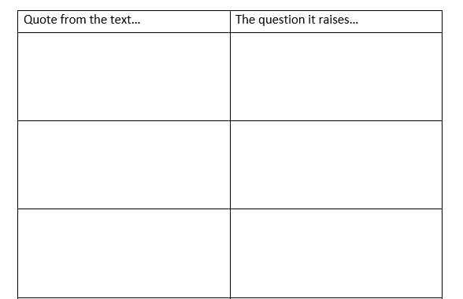
Example:
“I wish I could wake up to another Monday like that.”
What’s happened to make him wish it was a cold, grey Monday?
“Those days are gone now that the Bluchers are here.”
What are the Bluchers and how did they change day to day life?
“…when mum wasn’t well.”
What’s wrong with mum? Is she unwell a lot?

Slide 10
Boy in the Tower
Wednesday Lesson Three:
Read chapter 2 and write a summary of the chapter

Slide 11
Boy in the Tower
Thursday Lesson Four:
Activity 2

Slide 12
Vocabulary for Chapter 2
Can you come up with definitions for these words?
shepherding
slick
drizzle
bickering
Notes:
Vocabulary information

Slide 13
Vocabulary for Chapter 2
Can you come up with definitions for these words?
shepherding
To guide in a particular direction
Smooth and glossy or operate in an efficient way
slick
drizzle
Light rain or a liquid trickled over food.
bickering
Arguing about a petty matter
Notes:
Vocabulary information

Slide 14
Questions to consider after reading Chapter 2.
What is the name of the narrator’s best friend?
Something unusual has been happening in their town. What is it?
How does the author convey to the reader that something isn’t quite right?

Slide 15
Questions to consider after reading Chapter 2.
What is the name of the narrator’s best friend?
Gaia
Something unusual has been happening in their town. What is it?
It’s been constantly raining
How does the author convey to the reader that something isn’t quite right?
The strange weather without any explanation. The sense of unrest in the adults in the school.

Slide 16
In Chapter Two, we learnt quite a bit about the narrator and his best friend, Gaia.
Sometimes we can just retrieve facts from the text:
Gaia liked the rain.
The narrator likes balancing on the tops of walls.

Slide 17
However, sometimes we can interpret what is said to give us more information about a character.
What do these quotes tell you about Gaia?
“Her face broke into a smile first.” (page 10)
She’s good fun to be around. She likes a joke with her friend. She isn’t moody. She isn’t precious about her appearance.
“Gaia was watching the adults on duty carefully.” (page 11)
She’s inquisitive. She’s perhaps a little nosey.

Slide 18
Your Task
Your task is to create a mind map about Gaia and the narrator. The mind map should contain facts that you’ve retrieved from Chapter 2 and also information that you have interpreted.
Challenge: If you are interpreting information, include the evidence for this on your mind map too.

Slide 19
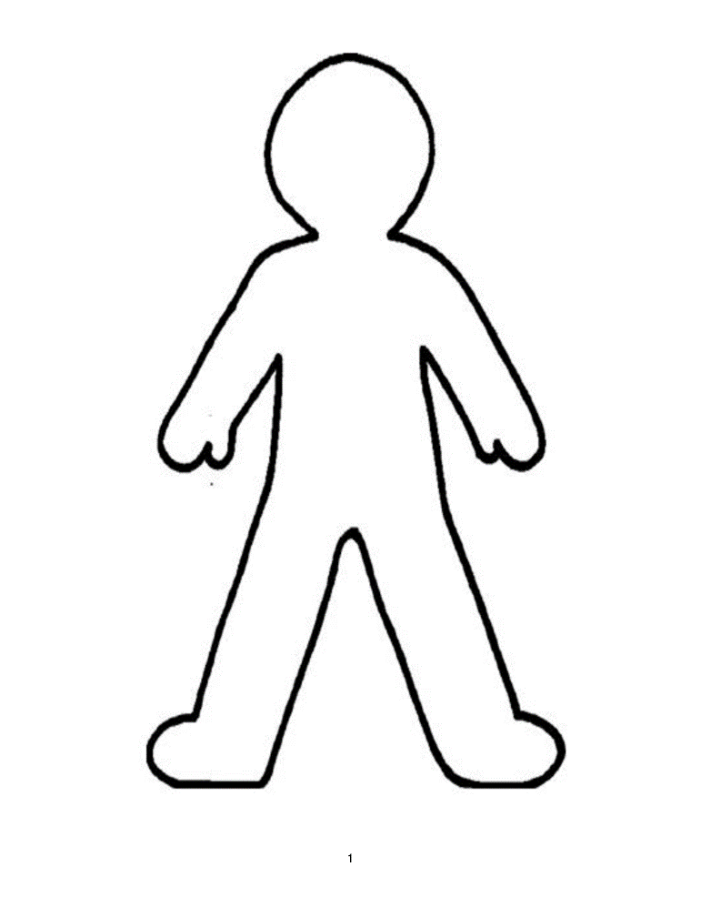
EXAMPLE
Gaia likes the rain
Gaia can lip-read
Gaia is nosey as she lip reads the teachers’ conversations
Which pieces of information have we retrieved and which have we interpreted?
Challenge: Can you
colour-code these on your mind map accordingly?
GAIA

Slide 20
Boy in the Tower
Friday Lesson 5:
Read chapter 3/4 and write a summary of the chapters

Slide 21
Boy in the Tower
Monday Lesson six:
Read chapter 5 and write a summary of the chapter

Slide 22
Boy in the Tower
Tuesday Lesson Seven:
Read chapter 6 and write a summary of the chapter

Slide 23
Boy in the Tower
Wednesday Lesson Eight:
Read chapter 7 and write a summary of the chapter

Slide 24
Boy in the Tower
Thursday Lesson Nine:
Activity 3

Slide 25
We have now read up to Chapter 7. What have we learnt about Ade’s mum so far?
What do you think is the matter with Ade’s mum? Why do you think this?
Why do you think her condition started?

Slide 26
Vocabulary for Non-Fiction Work
Can you come up with definitions for these words?
irritable
gets annoyed easily
anxiety
a sense of feeling worried and uneasy
apprehensive
worrying that something bad might happen
traumatic
deeply distressing
Notes:
Vocabulary information

Slide 27
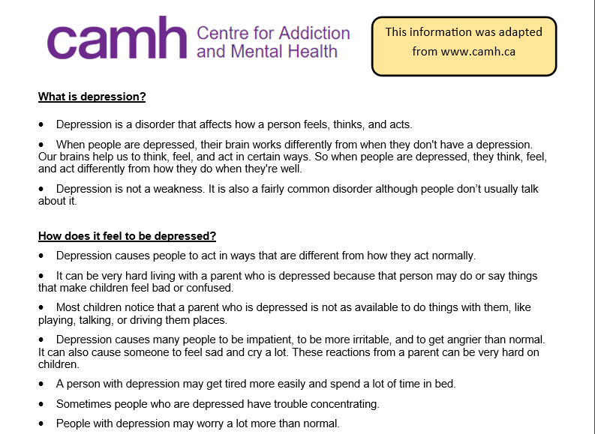
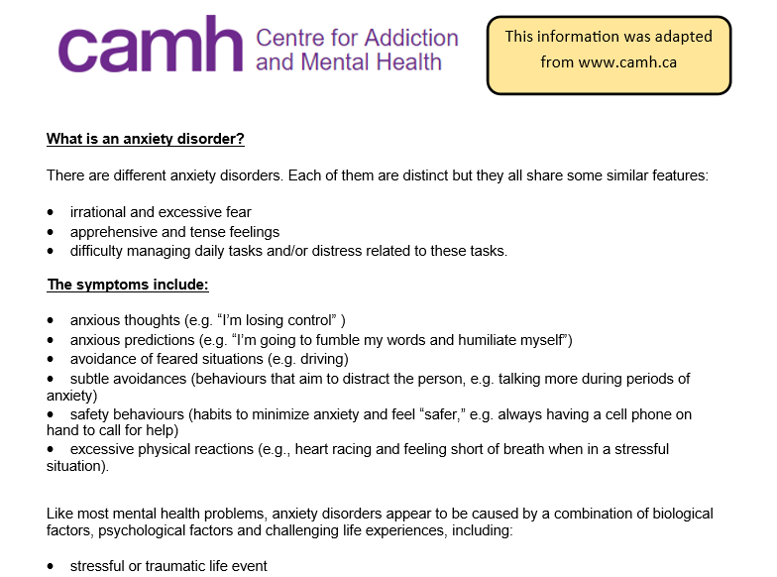
Today we are going to learn a little bit more about two conditions…

Slide 28
Read through the following pages in Boy in the Tower:
Pg25-27
Pg30-32
Pg35-37
Can you find any evidence of Ade’s mum having one, both or neither of these conditions?

Slide 29
Your Task
Answer these three questions:
What do you think is the matter with Ade’s mum?
What is your evidence for thinking this?
What would you advise Ade’s mum to do?
TOP TIP – Use the following pages to help you:
Pg25-27
Pg30-32
Pg35-37

Slide 30
Boy in the Tower
Friday Lesson Ten:
Activity 4

Slide 31
We have now read up to Chapter 7.
What do we know so far?
What do you predict is going to happen?
Write a prediction using evidence from the text to support.

Slide 32
Boy in the Tower
Monday Lesson eleven:
Read chapter 8 and write a summary of the chapter

Slide 33
Boy in the Tower
Tuesday Lesson Twelve:
Read chapter 9 and write a summary of the chapter

Slide 34
Boy in the Tower
Wednesday Lesson Thirteen:
Activity 5

Slide 35
Speedy Retrieval (from pg 48-51)
Are these statements true or false?
Ade’s teacher was called Miss Farraway
The thing Ade liked most about school was playtime.
Everyone at school was talking about the pub that had fallen down.
Ade picked out an orange flower pot.
Gaia spoke to Ade to ask him if he was OK.
Ade liked touching the soil.
Notes:
Vocabulary information

Slide 36


Speedy Retrieval (from pg 48-51)
Are these statements true or false?
Ade’s teacher was called Miss Farraway
The thing Ade liked most about school was playtime.
Everyone at school was talking about the pub that had fallen down.
Ade picked out an orange flower pot.
Gaia spoke to Ade to ask him if he was OK.
Ade liked touching the soil.
Notes:
Vocabulary information

Slide 37
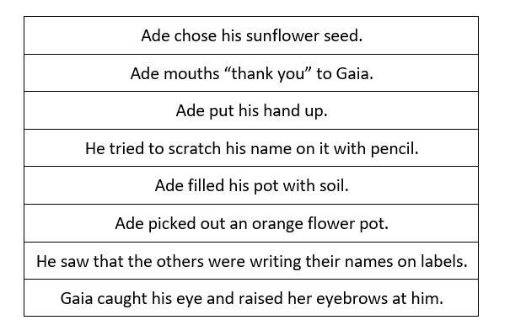
Can you put these events in Chapter 9 in order? (pg 48-52)

Slide 38
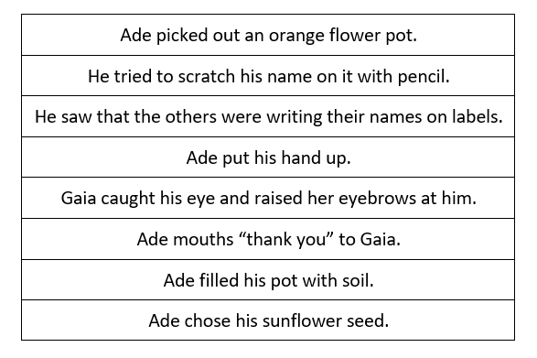
ANSWERS:

Slide 39
How do Gaia’s emotions change through Chapter 9? Use a range evidence to support your viewpoint.
What do the actions of Ade at the end of Chapter 9 tell us about his character? Use a range of evidence to support your viewpoint.

