Slide 1
Crime Project; LITTER
Brought to you by the School Council

Slide 2
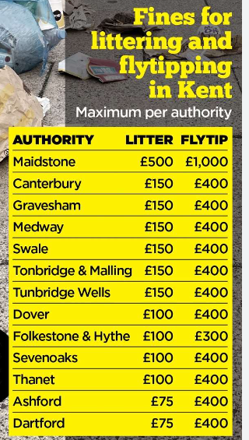
Litter Project
AT Swingate, we had noticed an increase with litter in and around our school and we wanted to do something about it…

Slide 3


Step 1
Year 5 had already taken part in the ‘litter Angels’ project set by Medway Council in September.
We had a winning entry in one of our year 5 classes, Saturn Class.

Slide 4

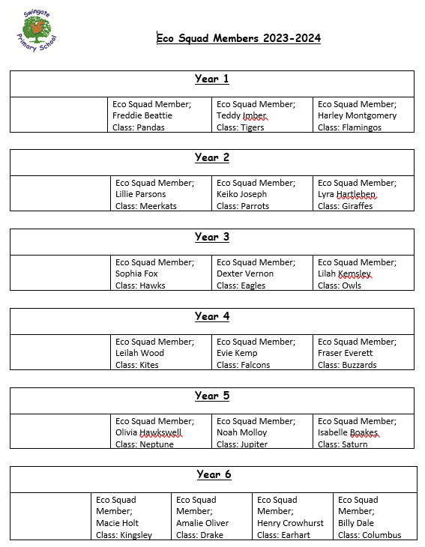
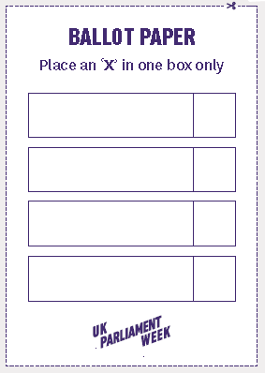
Step 2
We set up an Eco Squad during Parliament Week. These children were voted for in a democratic way.

Slide 5
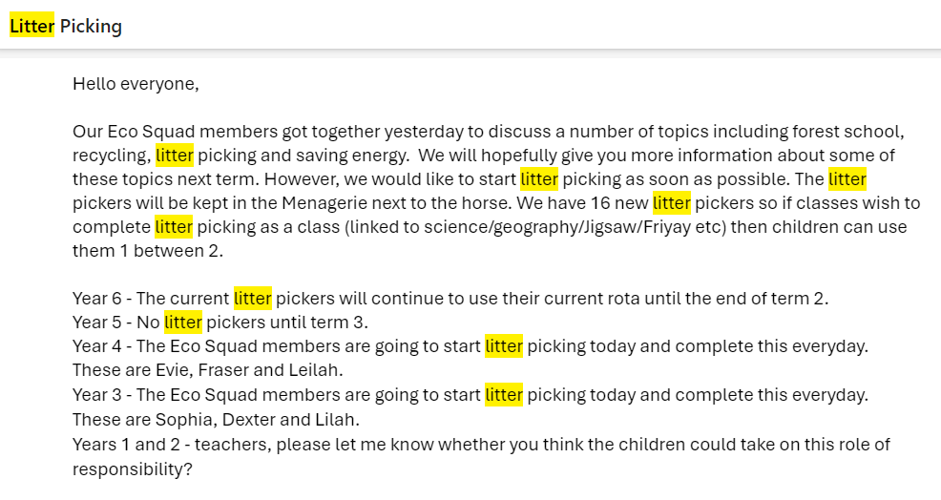
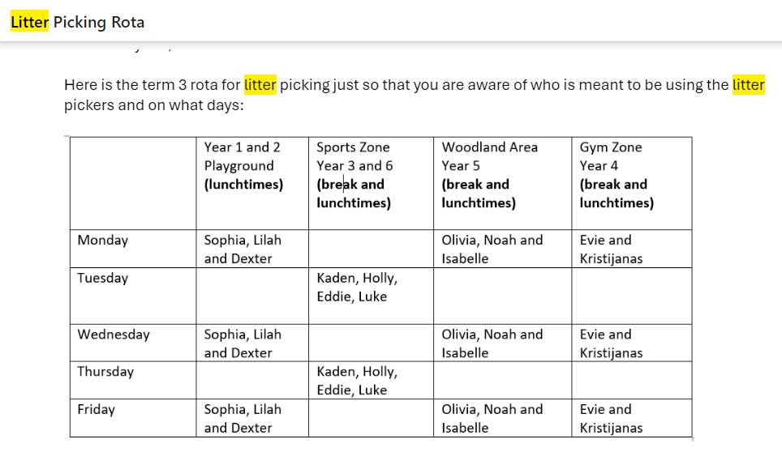
Within the eco squad, litter pickers were chosen for each playground. These children complete litter picking a minimum of 2-3 times a week at breaks and lunches.

Slide 6


We made our own badges to wear.
Step 3
Swingate signed up to ‘Litter Heroes’ run by ‘Keep Britain Tidy’.

Slide 7
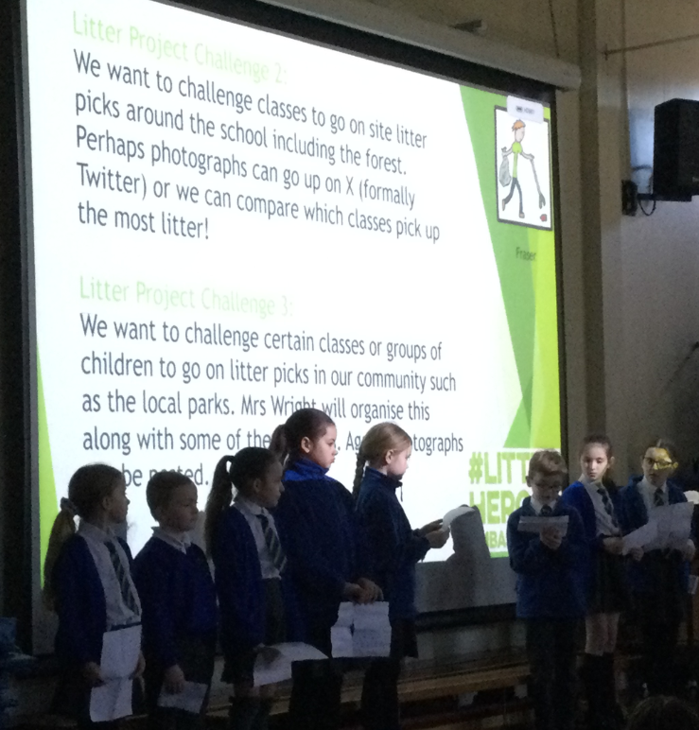
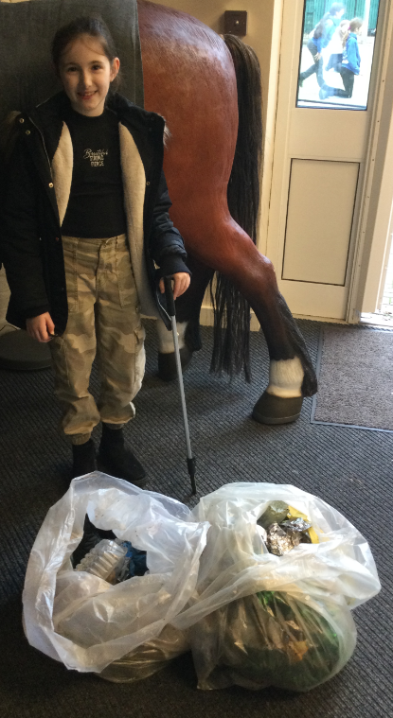
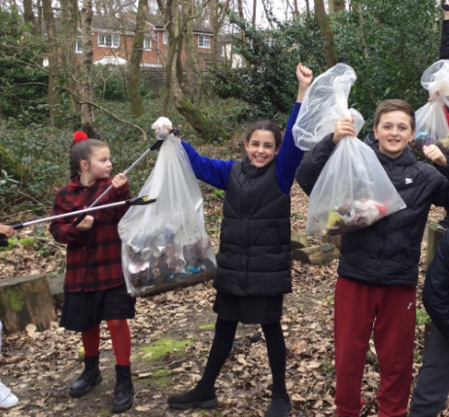
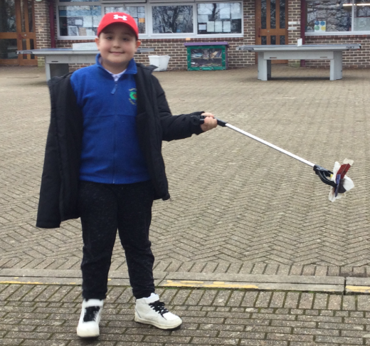
Step 4
The eco squad ran an assembly to encourage classes to litter pick around the school and forest school.

Slide 8
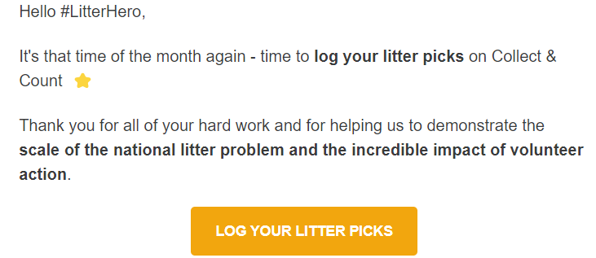


some classes have found bags full of rubbish. These have been logged with ‘Keep Britain Tidy’!

Slide 9

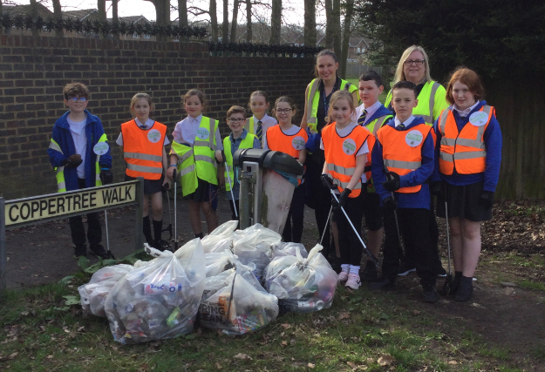
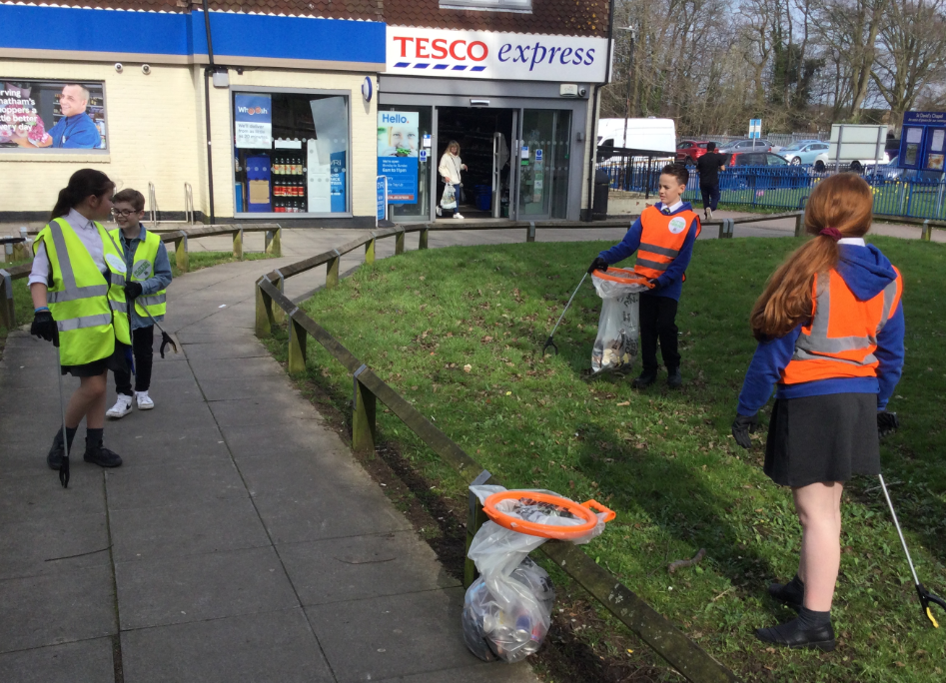
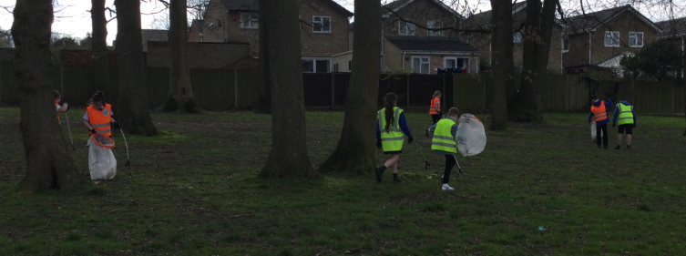
Step 5
We took part in the Great British Spring Clean by organising a local litter pick around the school community. Our local Medway representative, Amanda Kemsley, helped us out.

Slide 10

Step 5
Swingate are aiming to gain the Eco Schools Green Flag award for all the hard work they are doing to help make Swingate a Green School.

Slide 11

Litter Project
We hope we have started to make a difference within our school community and encouraged everyone to stop dropping litter!

