Slide 1
Recycling Project
Brought to you by the School Council

Slide 2

The school council feel passionate about our planet and have embarked on a recycling project that they would like everyone to get involved with.
We are going to start with the following ideas. So please, be part of the solution and not part of the pollution!

Slide 3



Saving Energy

Slide 4

Recycling Pledge 1: Each class will have 2 Eco Warriors who will turn off lights, interactive boards and taps.
School Council children in your class are going to choose 2 children to become the Eco Warriors for their class. Whenever the class leave the room (PE, library, lunch etc) and no-one is left in there, they will switch off the lights, interactive boards and any taps that you have. Special labels will be produced to help remind them about this.
Be energy aware so there’s a future to share!

Slide 5
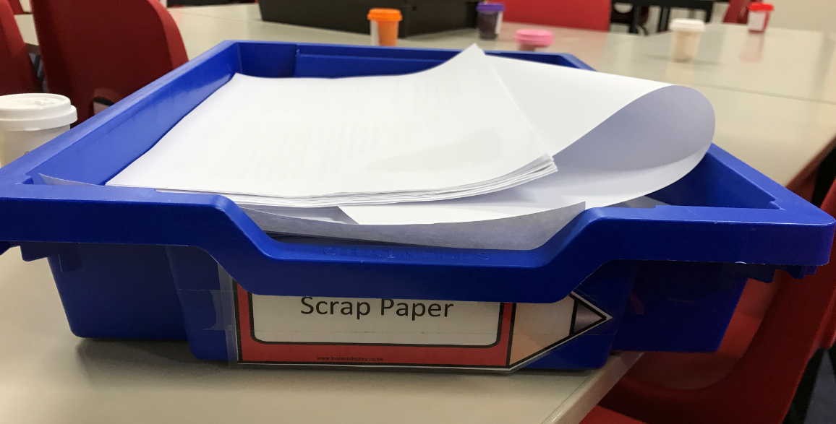
Saving Paper

Slide 6

Recycling Pledge 2: Each class will have a scrap paper tray.
Each class need to have a tray for scrap paper. Any worksheets that are no longer needed can be added to the tray and children can be given opportunities to use it such as during wet play, Friyay or to take home on a Friday or end of term.
So, be cool and recycle in school!

Slide 7
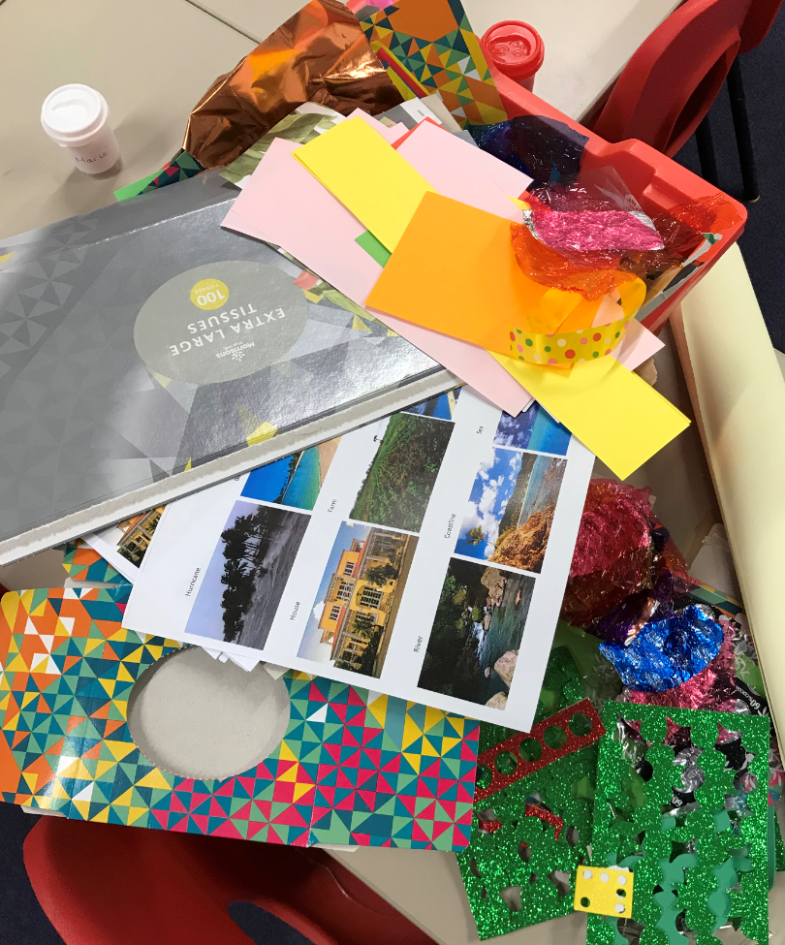
Repurposing

Slide 8

Recycling Pledge 3: Each class will have a ‘bits and bobs’ box.
Each class (or year group if easier) need to have a tray/box to keep any leftover bits and bobs. For example, display off-cuts, ribbon off-cuts, sweet wrappers, old birthday cards, old tissue boxes etc. This can then be used for craft activities, collage, Friyay or anything else!
Think about this; when you refuse to reuse, it’s our Earth you abuse!

Slide 9

Litter

Slide 10

Recycling Pledge 4: Year 5 will have Eco Warriors who will be in charge of the litter pickers.
Year 5 will be in charge of the litter pickers so if any rubbish is dropped (it shouldn’t be as we are all capable of putting rubbish in the bin) they will pick it up. Thanks Year 5, you’re going to do an amazing job! ☺
So remember, if you throw, the world will go!

Slide 11
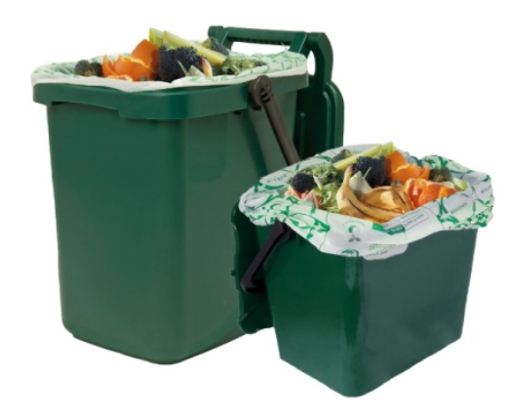
Food Waste

Slide 12

Recycling Pledge 5: All food waste from the hall and KS1 classrooms will go in the food waste bin.
Teachers and school council will help to make sure all food waste goes in the central food waste bin. This includes any leftover fruit from KS1 that other classes/Home from Home don’t want.
Let’s see food waste go from the garbage to the garden!

Slide 13
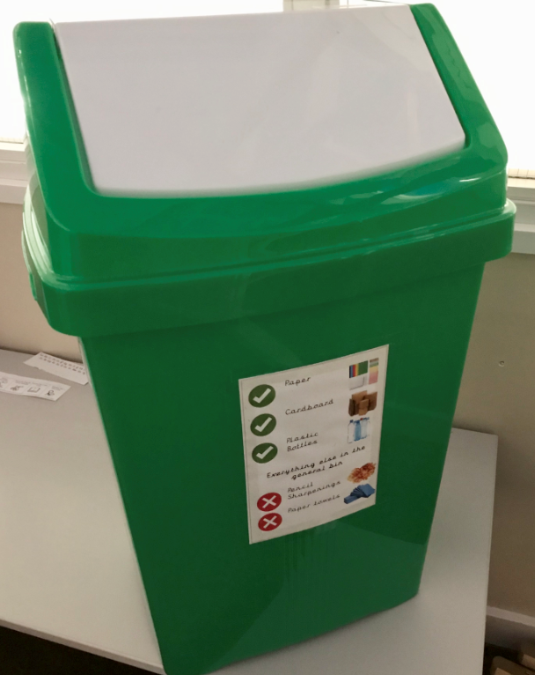
Recycling

Slide 14
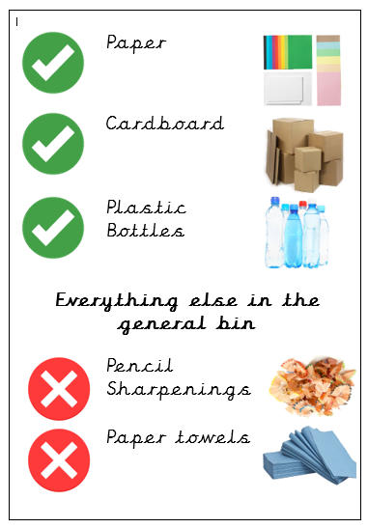

Recycling Pledge 6: Each class will have a green bin for recycling and a general bin for other rubbish.
This is very exciting! We finally get to recycle properly in our classrooms. However, it comes with big responsibilities. We must ONLY put paper, cardboard or plastic bottles in the green bin and everything else in the general bin. School Council have produced labels so you know what goes where.
Please don’t trash our future, recycle!

Slide 15
Now it gets exciting!
Some KS2 classes will now take their spare bins to the allocated KS1 classes and then collect their new green bins from the library!
Happy recycling everyone ☺

