Slide 1
Discrimination Project
By Swingate School Council

Slide 2
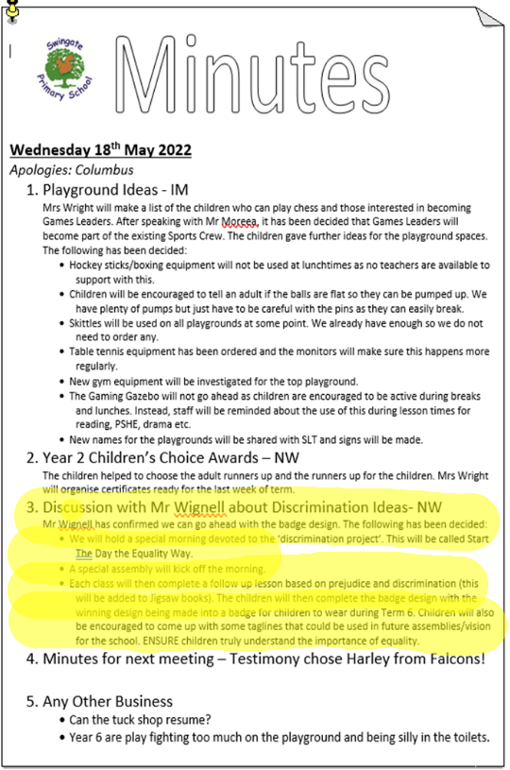
We already had some good ideas about our project at the previous Youth Council Meeting. We wanted to pursue the idea of a badge to promote equality. The first thing we did was have a KS2 meeting to put together our ideas.

Slide 3
We will hold a special morning devoted to the ‘discrimination project’. This will be called Start The Day the Equality Way.
A special assembly will kick off the morning.
Each class will then complete a follow up lesson based on prejudice and discrimination (this will be added to Jigsaw books). The children will then complete the badge design with the winning design being made into a badge for children to wear during Term 6. Children will also be encouraged to come up with some taglines that could be used in future assemblies or within our school vision.
After that, we invited our headteacher to our meeting so that he could listen to our ideas. We came up with the following…

Slide 4
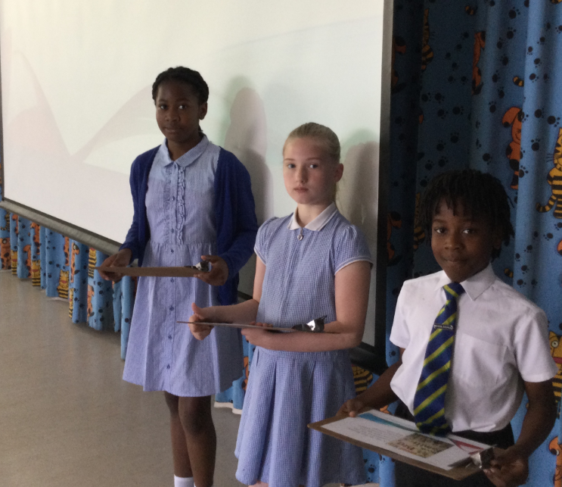
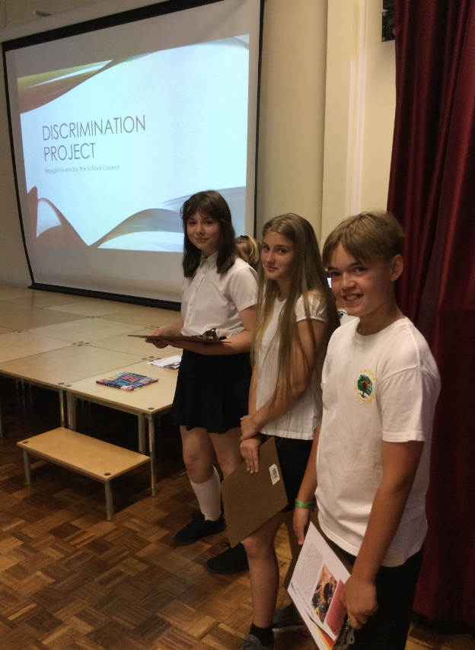

Members of the school council led assemblies for KS1 and KS2.

Slide 5
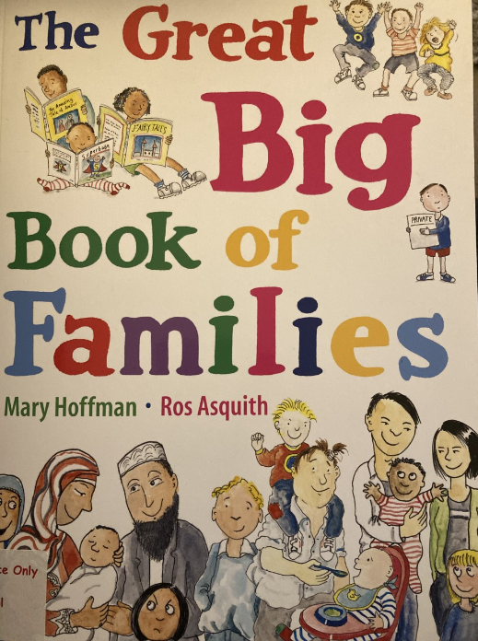

We took inspiration from books in the library. They were called ‘The Great Big Book of Families’ and ‘I Am Not a Label’.

Slide 6
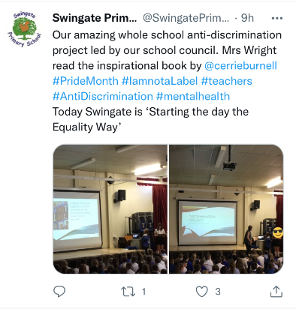
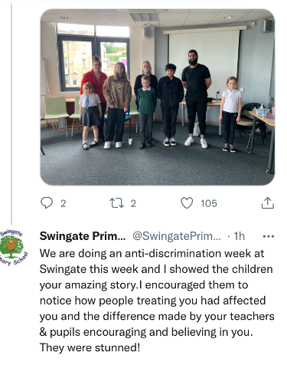
Our deputy head promoted the project on twitter.

Slide 7

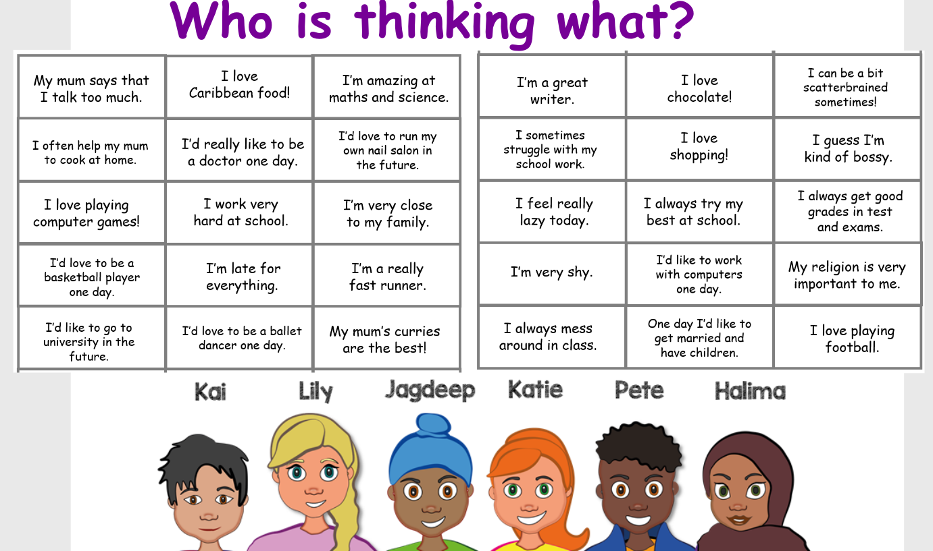
During the special day, we all took part in a lesson based on prejudice and discrimination.

Slide 8
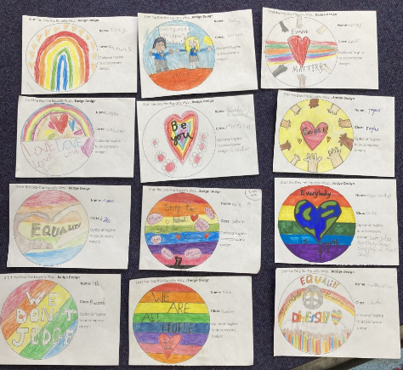
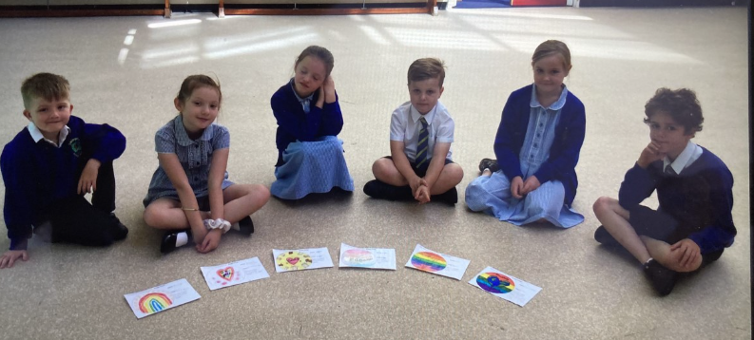
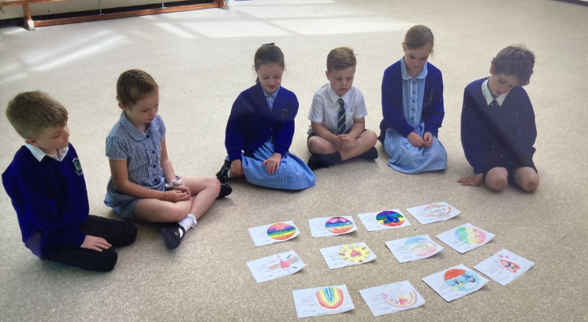
The Year 2 school council helped to choose some runner up designs so our leadership team could judge the final winner.

Slide 9
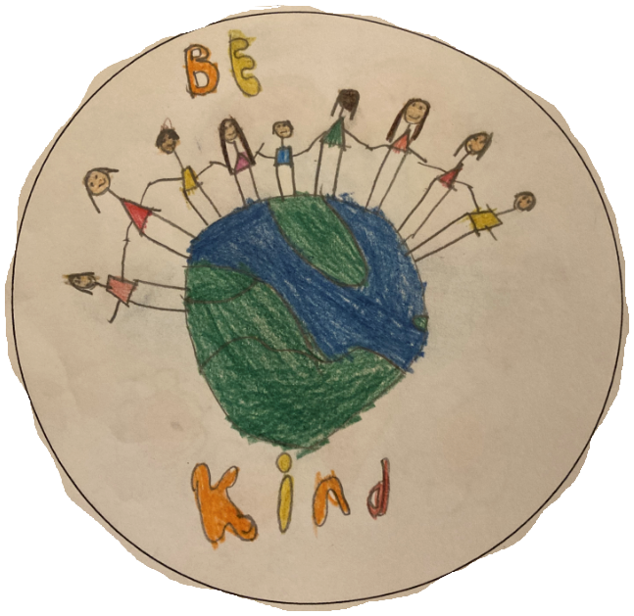
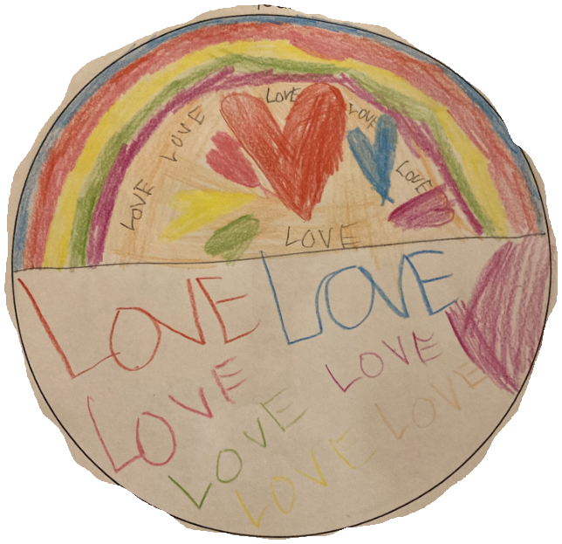
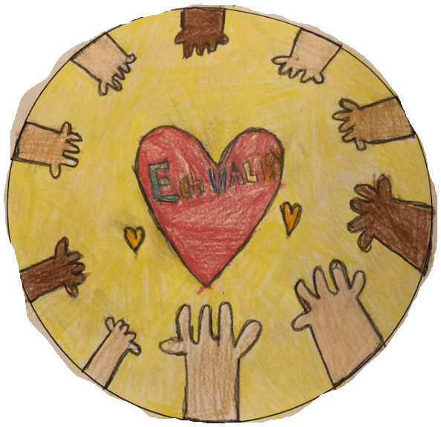
These are examples of the designs:
Year 2
Year 3
Year 1

Slide 10
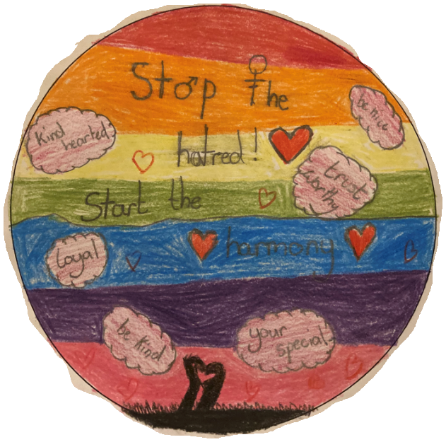

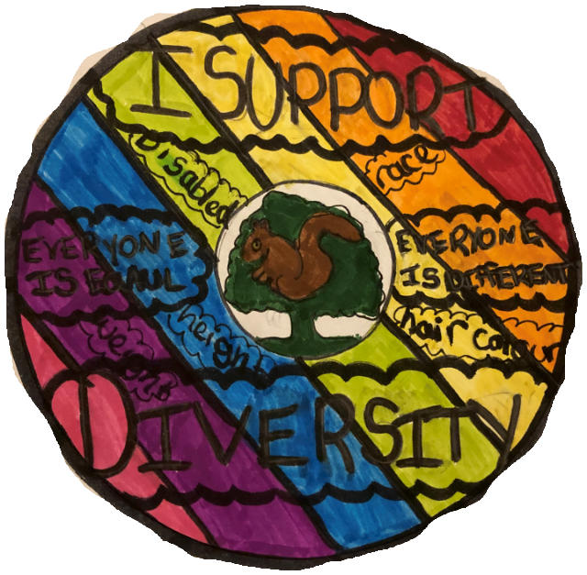
The children designed badges:
Year 5
Year 6
Year 4

Slide 11
A winning badge will be chosen next week and other children will receive runner up certificates.
The badge will be ordered so that children can wear it proudly for the last 3 weeks of term.
Teachers will continue to praise those who show a commitment to equality within our school.

Slide 12

Hopefully our school will stand together to support equality for all.
Thank you for listening!

