Slide 1
Responsibility
Brought to you by the School Council

Slide 2
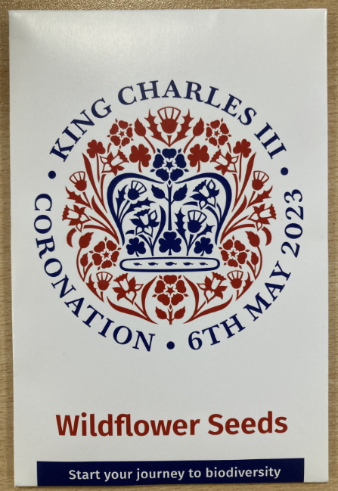
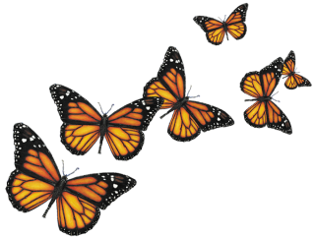
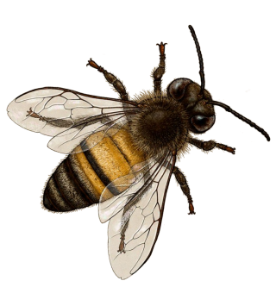
Swingate have been given a set of wildflower seeds as part of the Coronation celebrations.
King Charles is passionate about looking after our planet and these flowers will provide food for a wide range of insects, bees and butterflies.

Slide 3
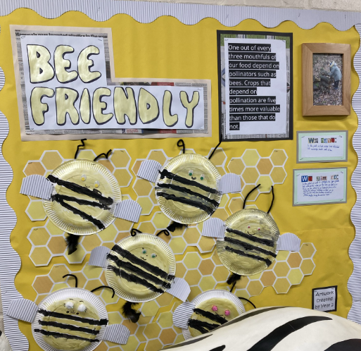
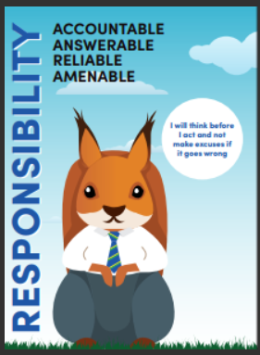
School Council have already been thinking about the importance of bees on one of the Eco Displays made by Year 2.
This also links to our value of responsibility because we are all responsible for looking after our planet and eco-system. So why are bees so important?

Slide 4
Bees
Bees are vital to our planet. Unfortunately, they are also in big trouble.
There are less bees in the UK now because of habitat loss, pollution and climate change. These tiny insects are an important part of our ecosystem, but with their numbers dropping, our natural world could be in serious trouble.

Slide 5
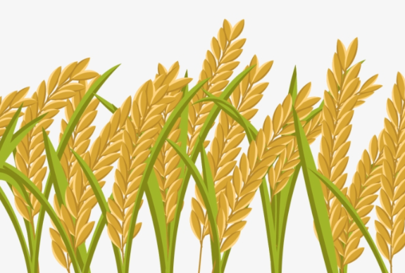
Bees pollinate food crops
In the UK alone, around 70 crops depend on or benefit from bee pollination. While there are other methods of pollination, including by other animals and the wind, wild bees can pollinate on a much bigger and more efficient scale.
Estimates suggest it would cost UK farmers an incredible £1.8 billion a year to manually pollinate their crops.

Slide 6
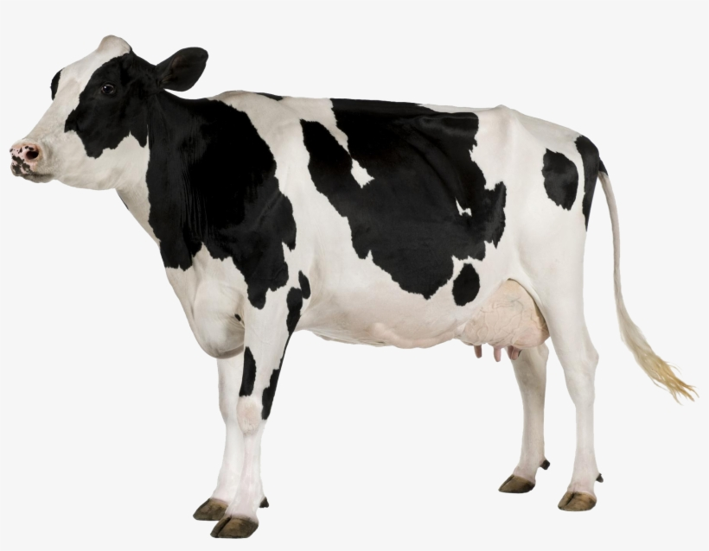
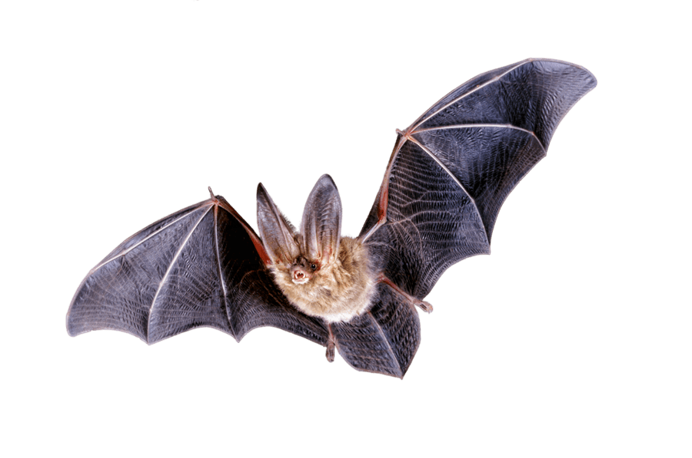
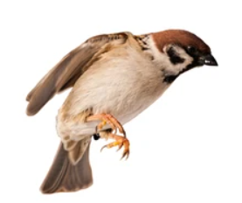
Bees feed livestock
Bees pollinate many of the crops used for animal feed. Without them, it would be harder to produce lots of our meat, egg and dairy products.
Bees prop up the ecosystem
Without bees, it wouldn't be long before our ecosystem collapsed. Bees pollinate our wild trees and wild flowers, which then support other insects, which then support birds, bats, mammals and everything up the food chain with food and shelter.

Slide 7
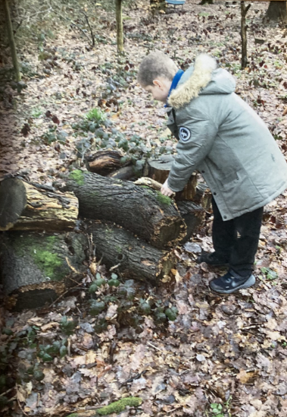
Our entire forest is such an important resource for us and should be used and looked after. The school council have come up with some ideas about looking after the wildlife within the forest and some fun activities that we could complete in there as part of our Friyay tasks. Let’s find out more…

Slide 8
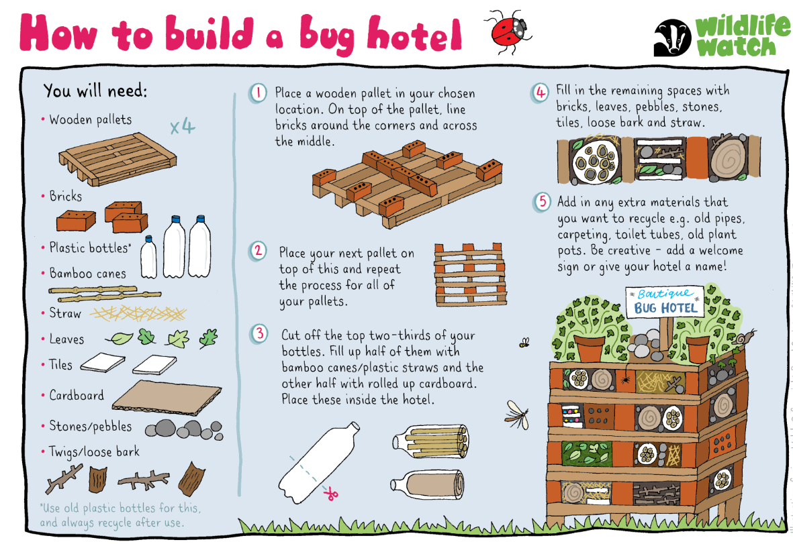
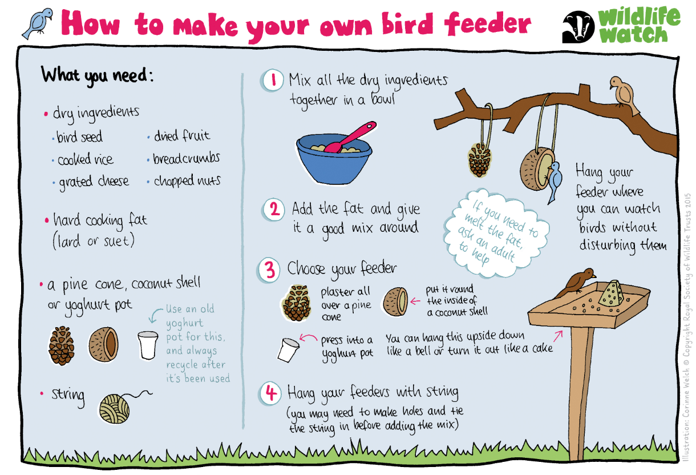
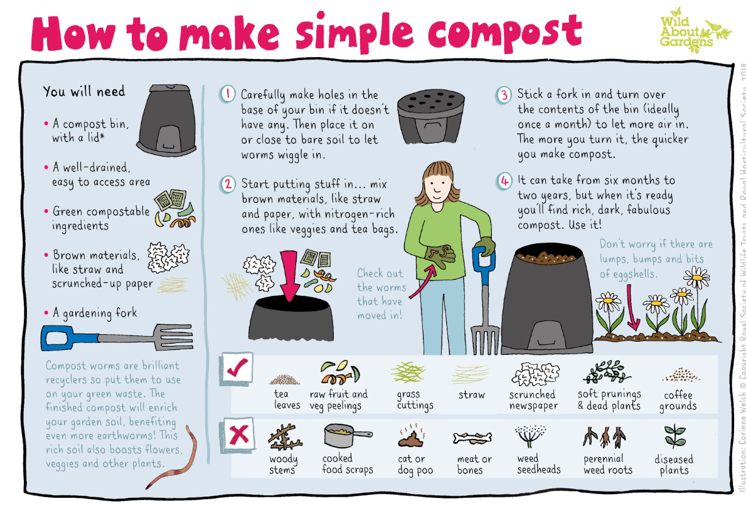
Activities to support wildlife:
Make a bird feeder
Make a bug hotel
Make your own compost
Make a garden wigwam

Slide 9
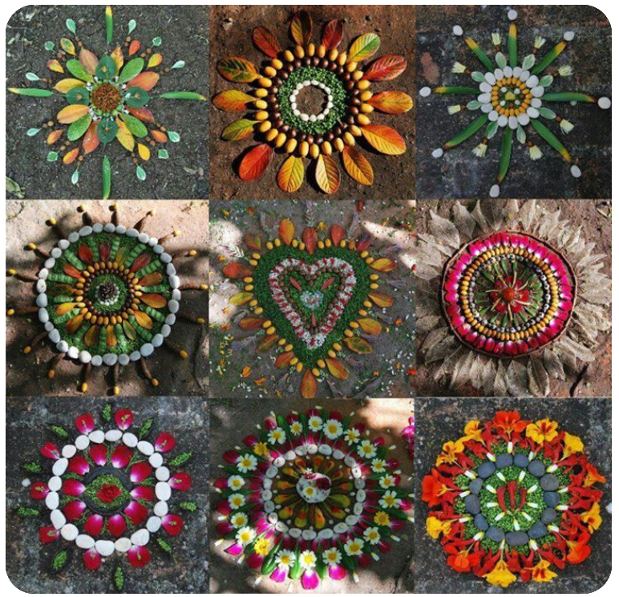
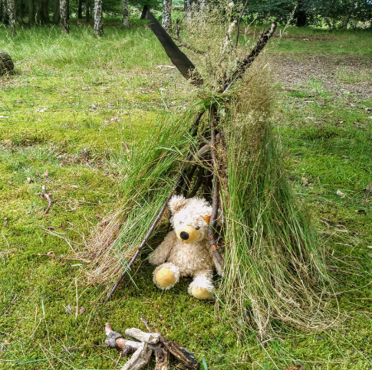
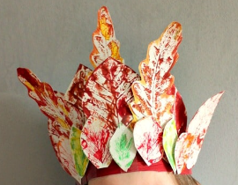
Activities for fun:
Make artwork using items from the forest
Going on a scavenger hunt
Make a teepee for a teddy
Make a crown out of leaves
Go on a bird watch
Make a bird nest
Decorate a tree
Make a mini raft

Slide 10
Let’s see whether Swingate School can show responsibility and get planting!
Each class will be given a pack of seeds so their school councillors can plant them in the forest.
You will also have access to a PowerPoint of Forest School ideas for you to try.

