Slide 1
Discrimination Project; Poverty
Brought to you by the School Council

Slide 2
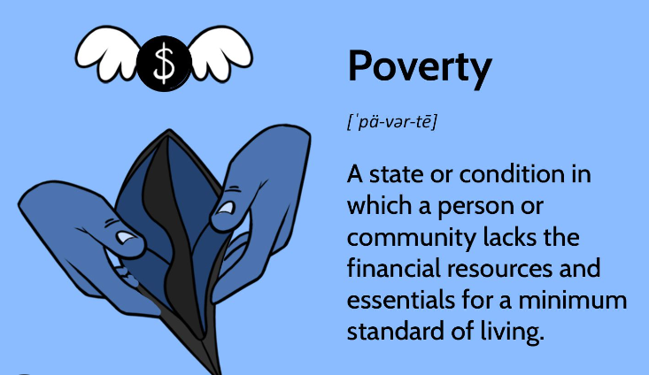
Poverty Project
We have continued to work hard on our poverty project. We will tell you all about what we have done…

Slide 3
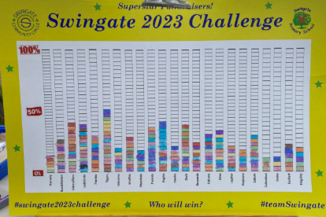
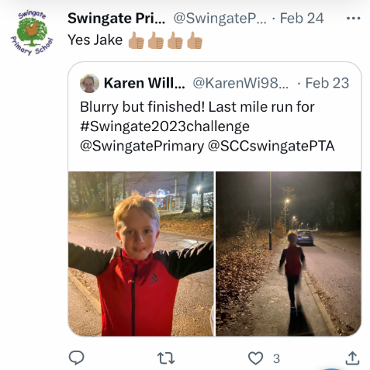
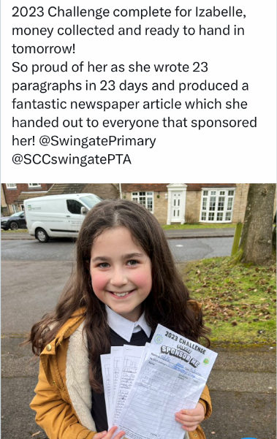
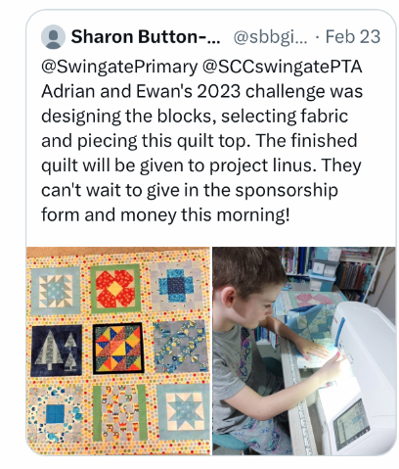
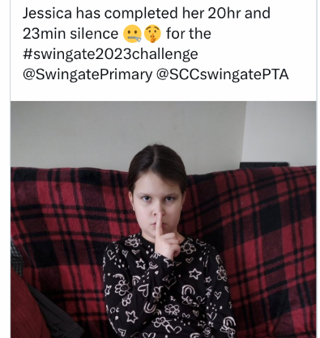
Fundraising
Our parent committee (SCC) encouraged us to raise money for our 2023 Challenge! We raised over £9,000!!

Slide 4


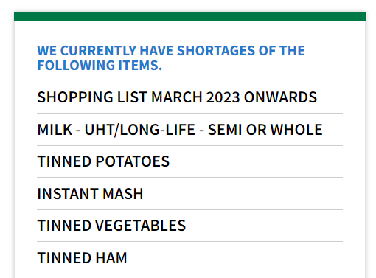
Medway Food Bank
We decided to use some of our fundraised money to buy goods to donate to the Medway Food Bank. Each class had £30 to spend on a given shopping list.

Slide 5
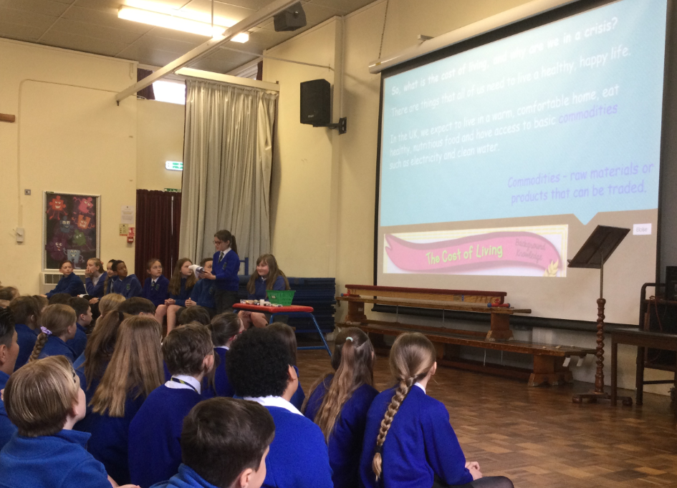
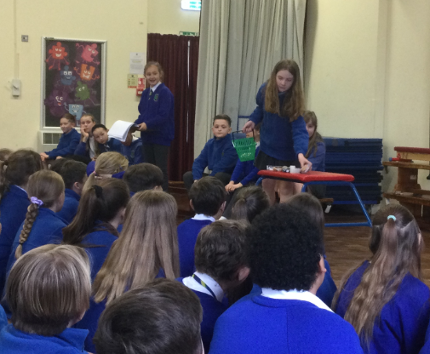
Assemblies
We completed assemblies for KS1 and KS2 to introduce the project. We also spoke about the ‘cost of living crisis’ to make the school aware that poverty can affect anyone.

Slide 6

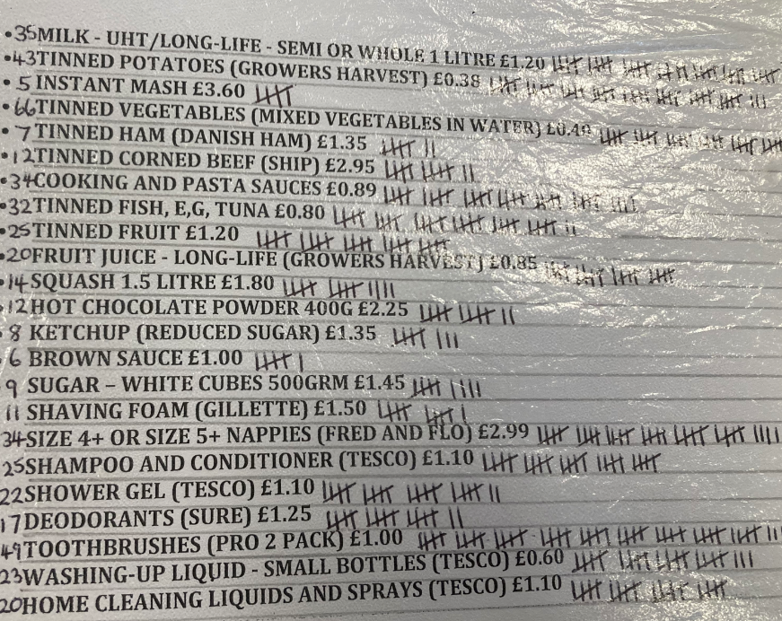
The school decided on the items they wanted to buy and a master shopping list was created.

Slide 7
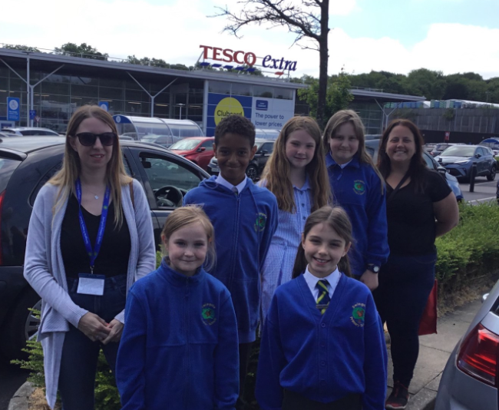
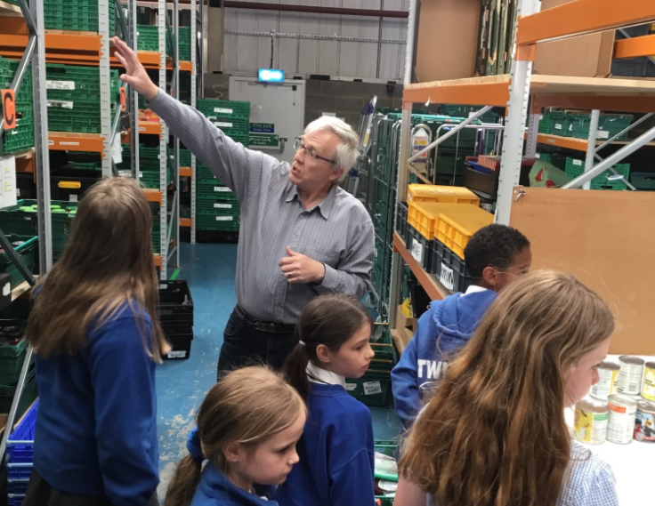
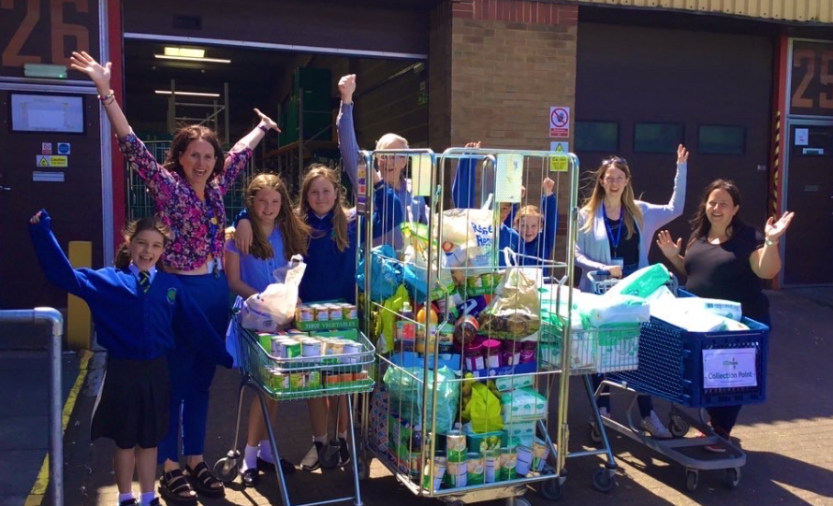
Food Bank Trip
Members of the SCC, head councillors and our School Council SLT member visited Tesco to buy the items and then donated it to the food bank.

Slide 8
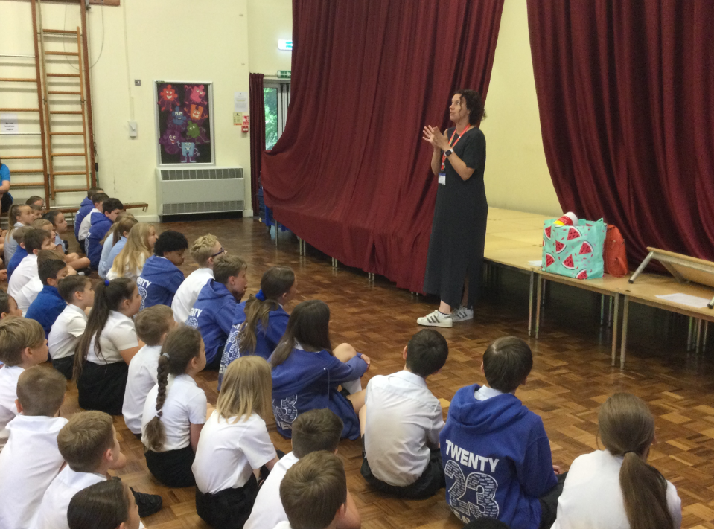
Food Bank Visitor
Sharon (one of the volunteers) came and gave us an assembly about the Food Bank and thanked us all for our donation.

Slide 9

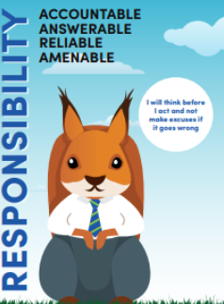
Poverty Project
We feel really proud about helping those in our community and have linked our project to our school values of responsibility, empathy, bravery and resilience.

