Slide 1
Forest school ideas bank
Brought to you by the School Council

Slide 2
PART ONE: ACTIVITIES TO SUPPORT WILDLIFE

Slide 3
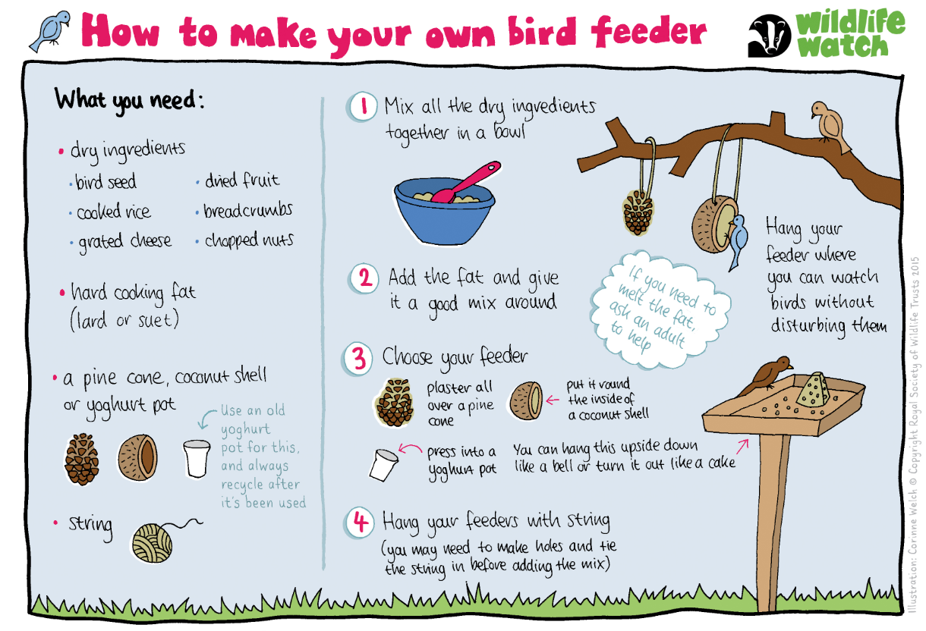
Make a bird feeder
Children can bring in some ingredients to help make bird feeders.

Slide 4
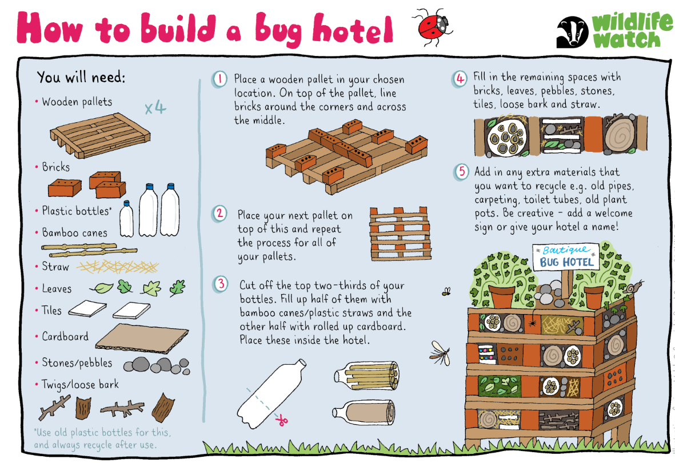
Make a Bug hotel
Children can either bring in items from home to make a bug hotel or twigs and branches can be used to extend the current hotels.

Slide 5
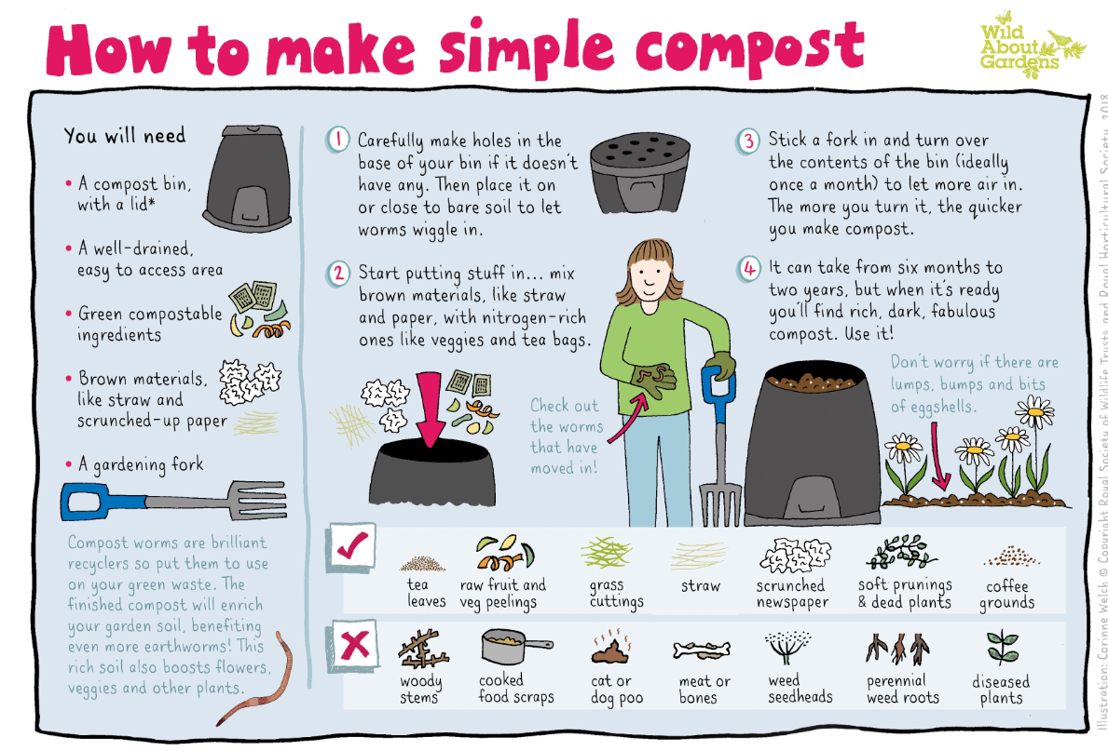
Make compost
Children can bring in items from home or organise within their classes ways to make compost.

Slide 6
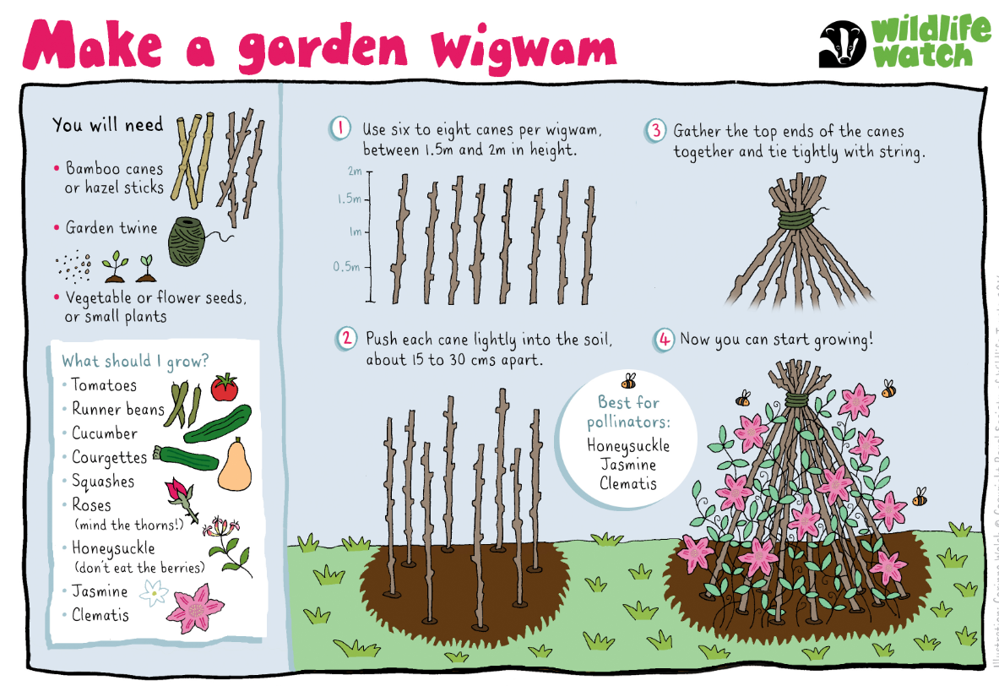
Make A GARDEN WIGWAM
Children could help to make the wigwams and help to plant different vegetables of flowers.

Slide 7
PART two: FUN ACTIVITIES

Slide 8
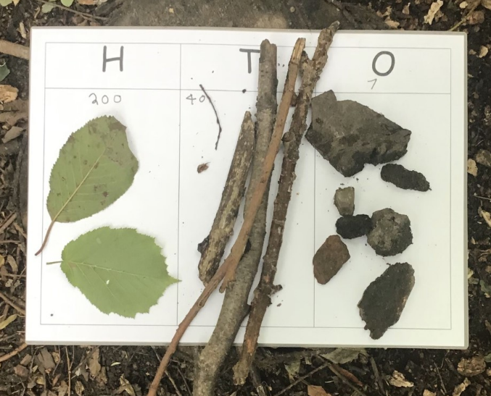
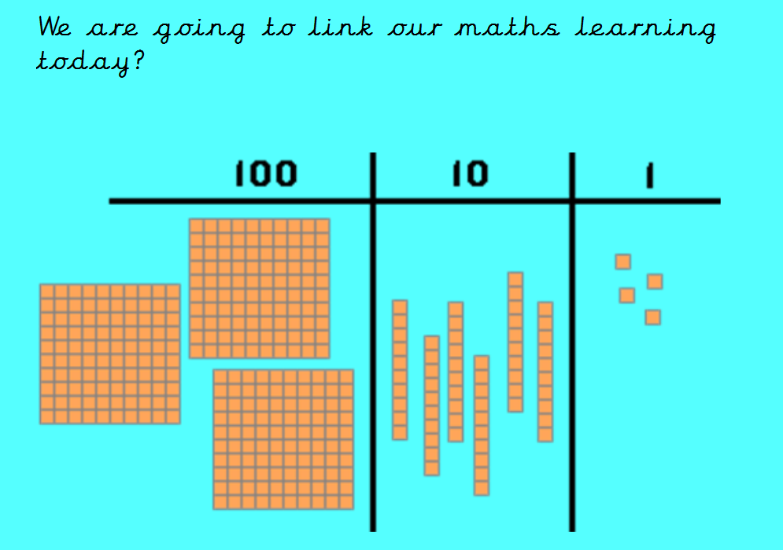
Link tasks to maths:
Example Task: Create your own representations of HTO and create 3 numbers. Challenge: Repeat for decimal numbers (Ones, tenths and hundredths) and make 3 numbers.

Slide 9

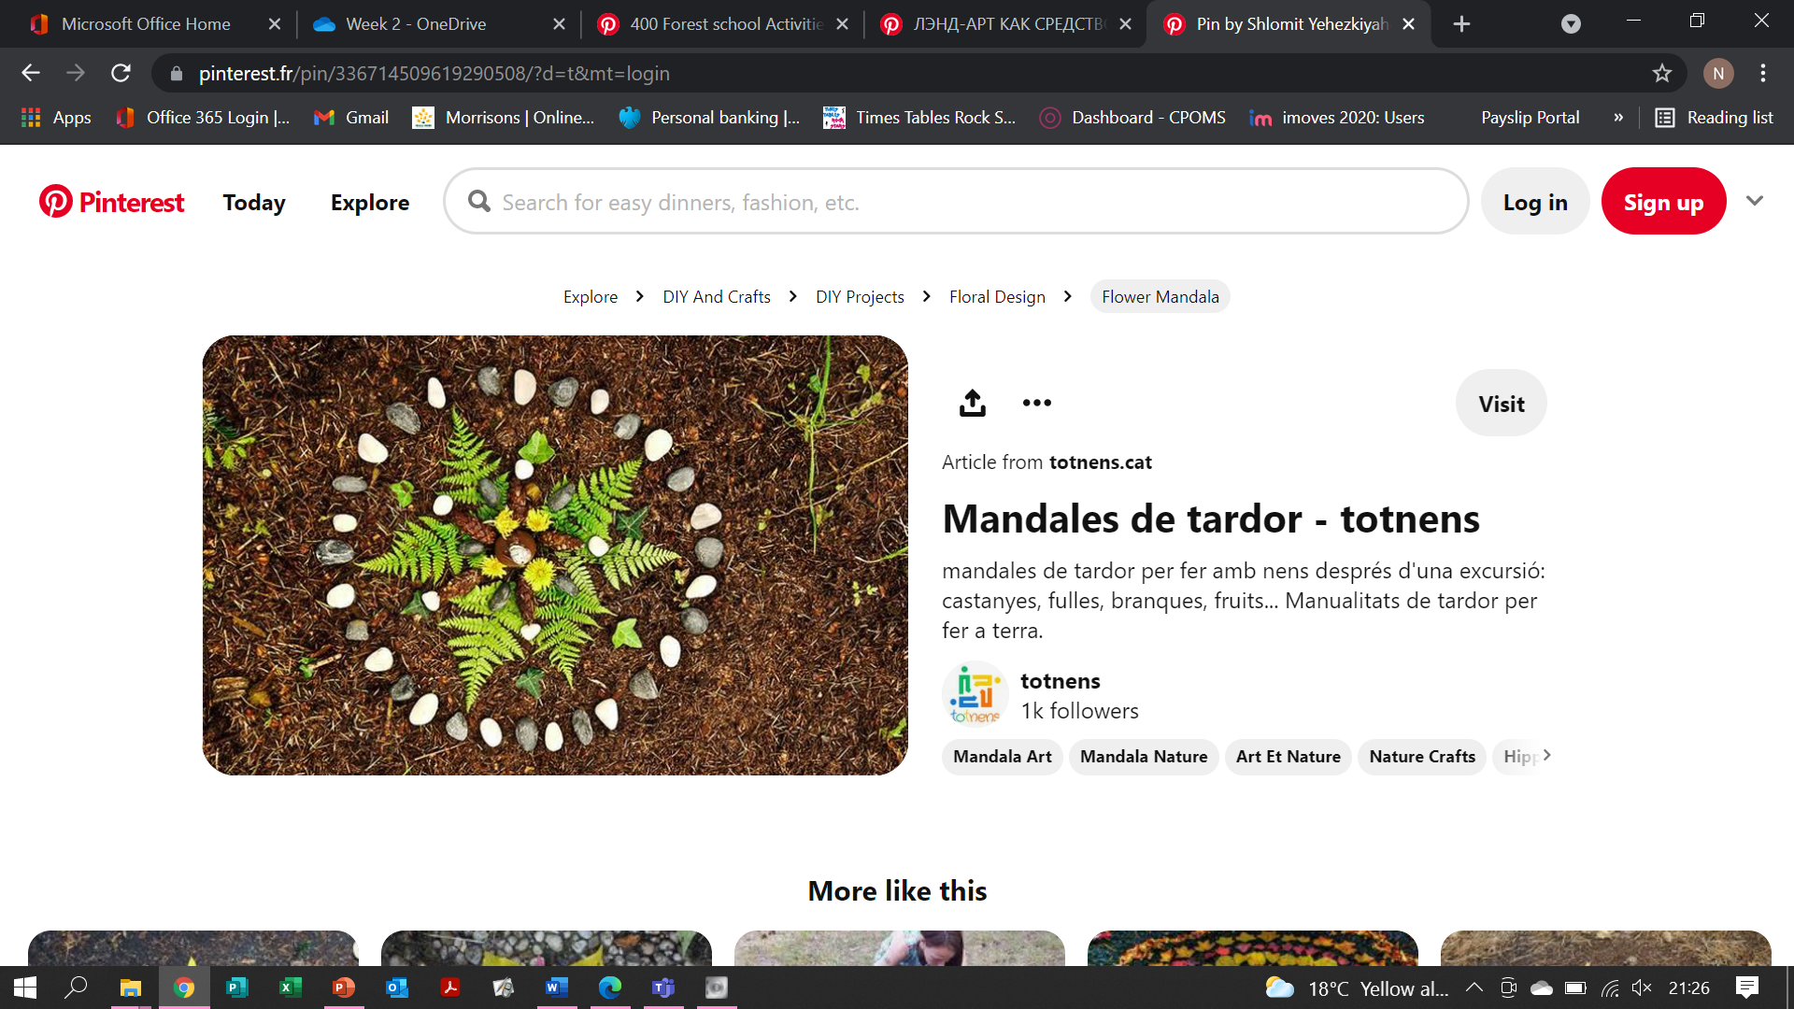
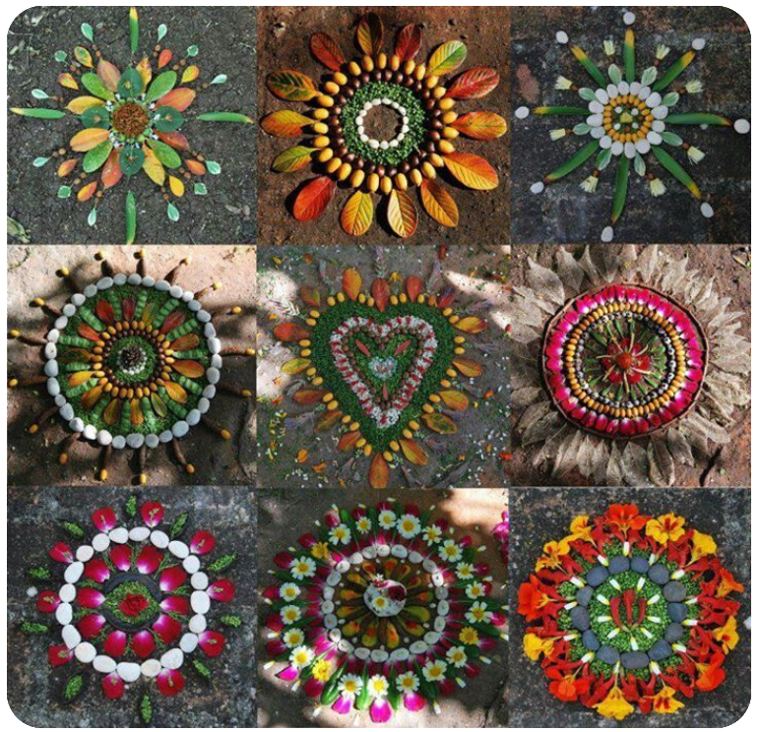
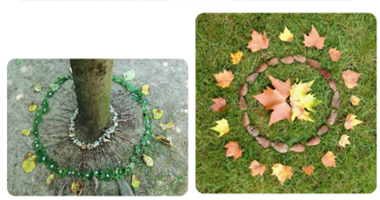
MANDALA ART (LINKED TO MAYANS/hindus)

Slide 10
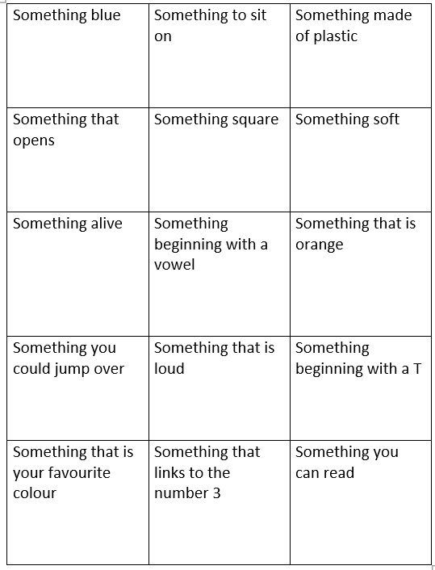
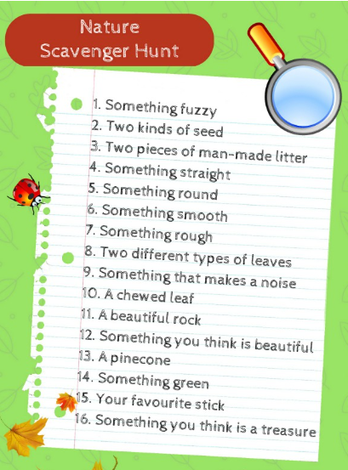
scavenger hunts
Example Task: Can you work with a partner to find a variety of items?

Slide 11
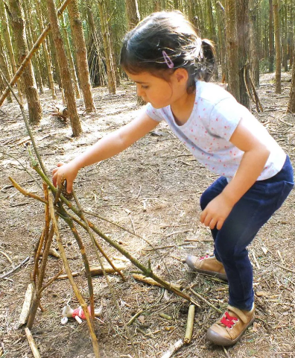
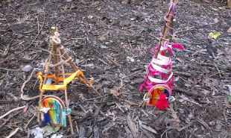
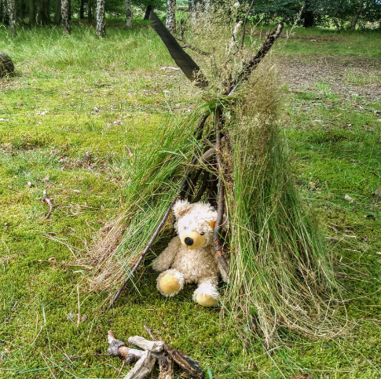
Teepees for teddies
Example Task: Who can make the best teepee for their teddy?
Can you protect your teddy from wind and rain?

Slide 12
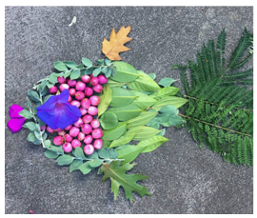
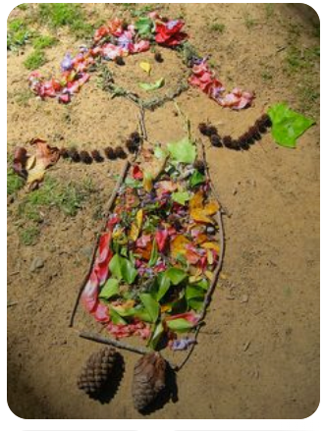
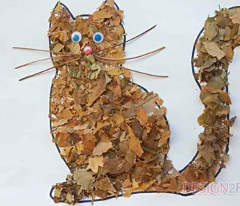
Create characters from class reads
Example Task: Who can make characters from class books using items found in the forest?

Slide 13
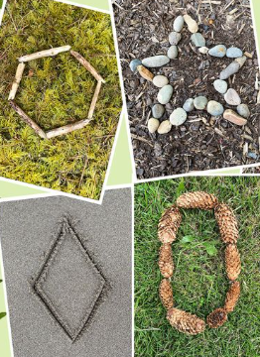
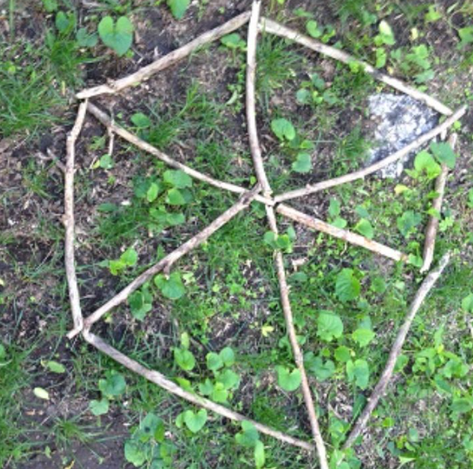
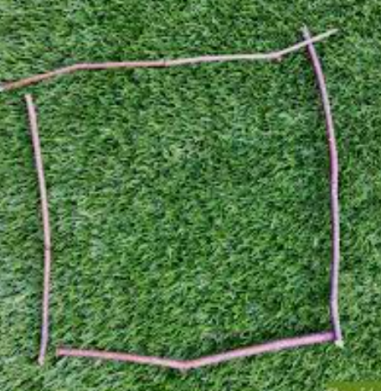
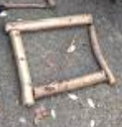
Mathematical shapes
Children can make different 2D shapes using forest school materials.
Challenge: Can you make a 3D shape?

Slide 14
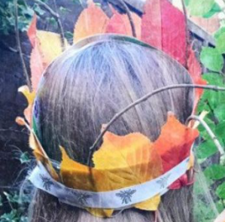
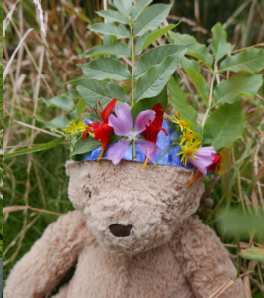
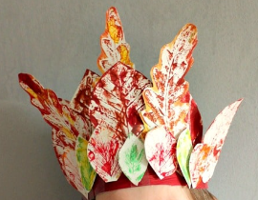
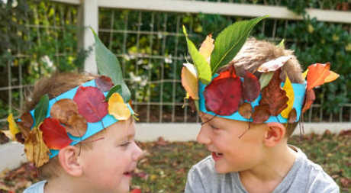
Leaf crowns
Children can make leaf/foliage crowns. This could be using leaf rubbings or actual leaves.
Challenge: Can you make a crown for your favourite teddy?

Slide 15
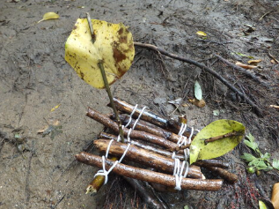
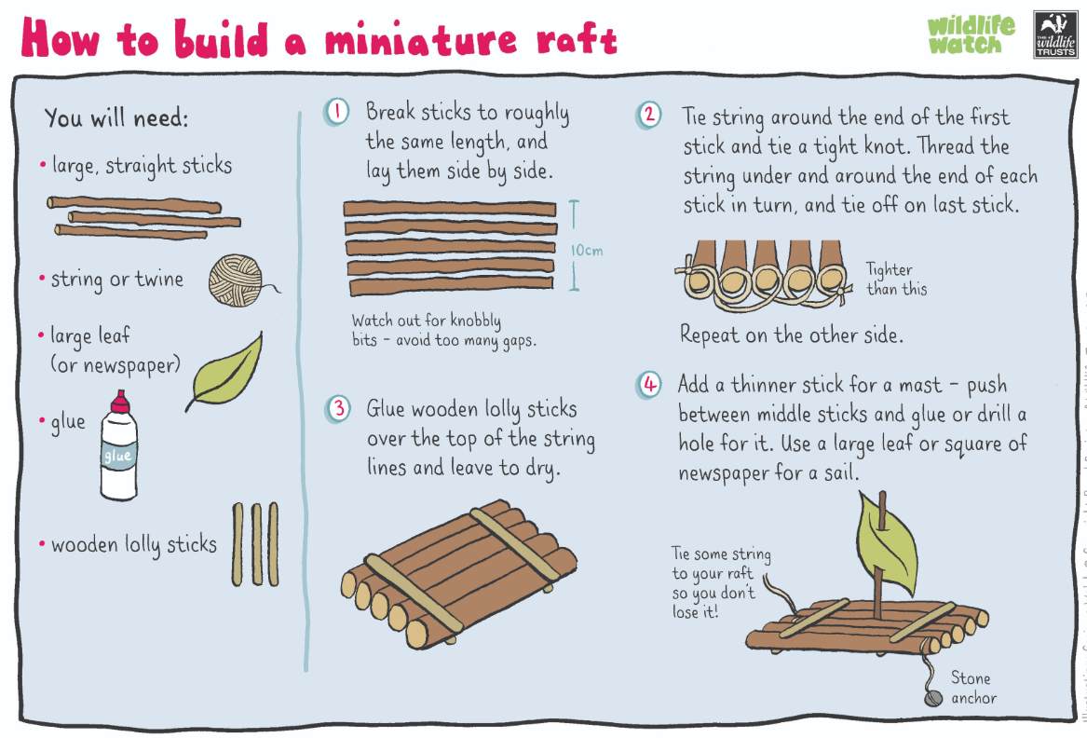
Mini rafts
Children to use items from the forest to make a mini raft.
Challenge: Can it float on water? Will it take passengers such as Lego characters?

Slide 16
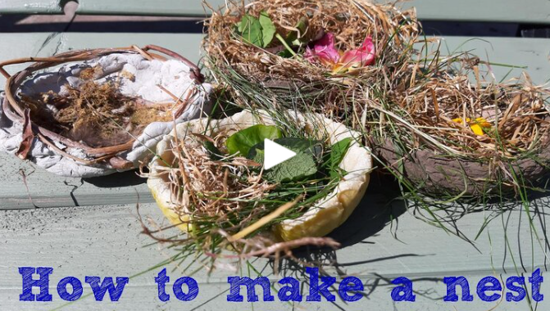
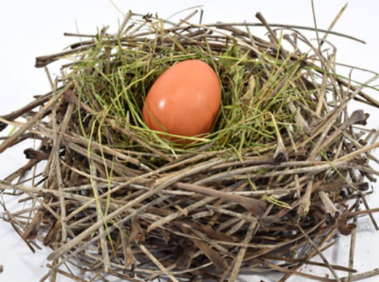
Bird nests
Children can gather items from the forest to make their own nests.
Will it support an egg?

Slide 17
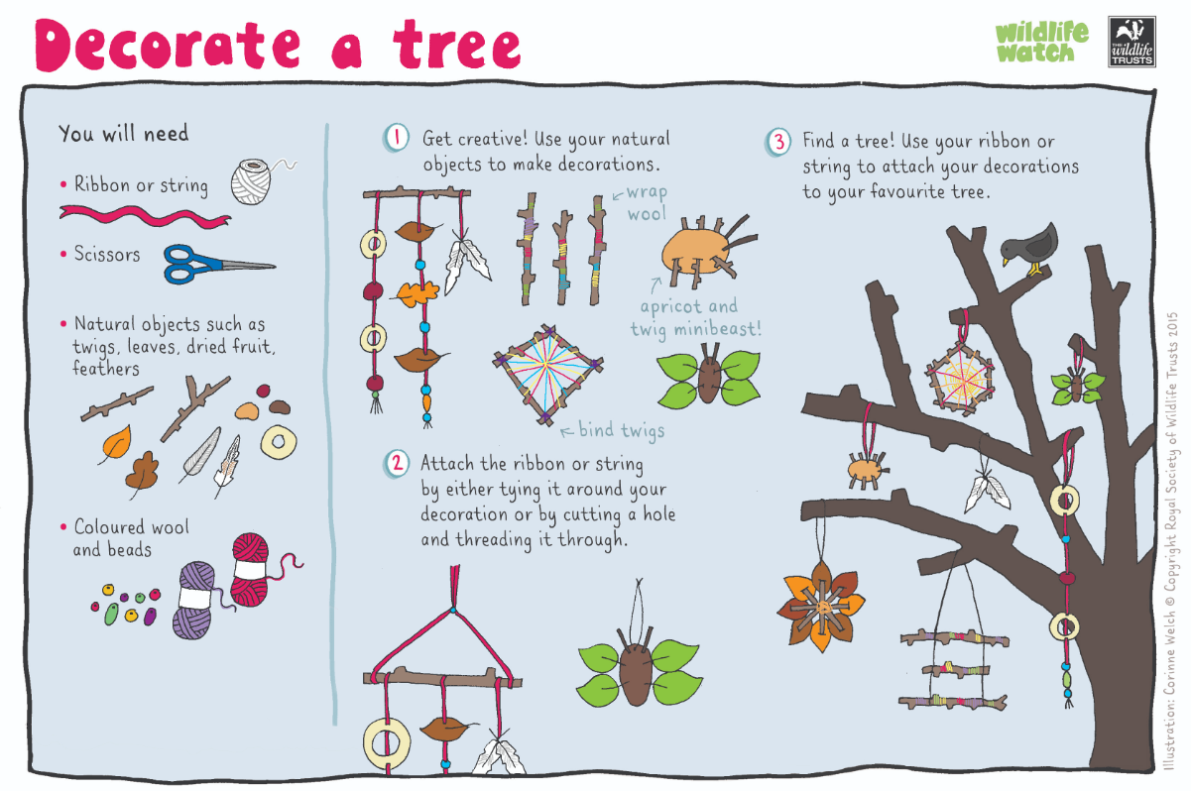
Decorate a tree
Children to use a variety of equipment to make decorations to go on a tree.

Slide 18
Useful websites:
https://www.wildlifewatch.org.uk/activities

